Slide 1

AI for Network Surveillance - Intelligent Intrusion Detection System
November 11, 2025
Dr. Padmalochan Bera
Associate Professor (CSE)
School of Electrical and Computer Sciences

Slide 2
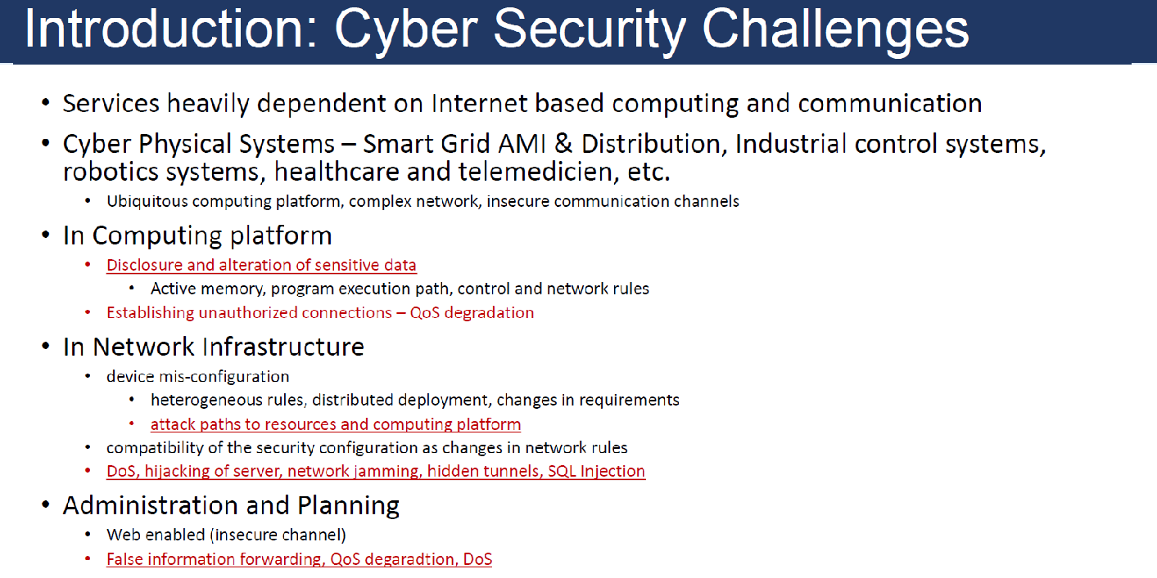

Slide 3
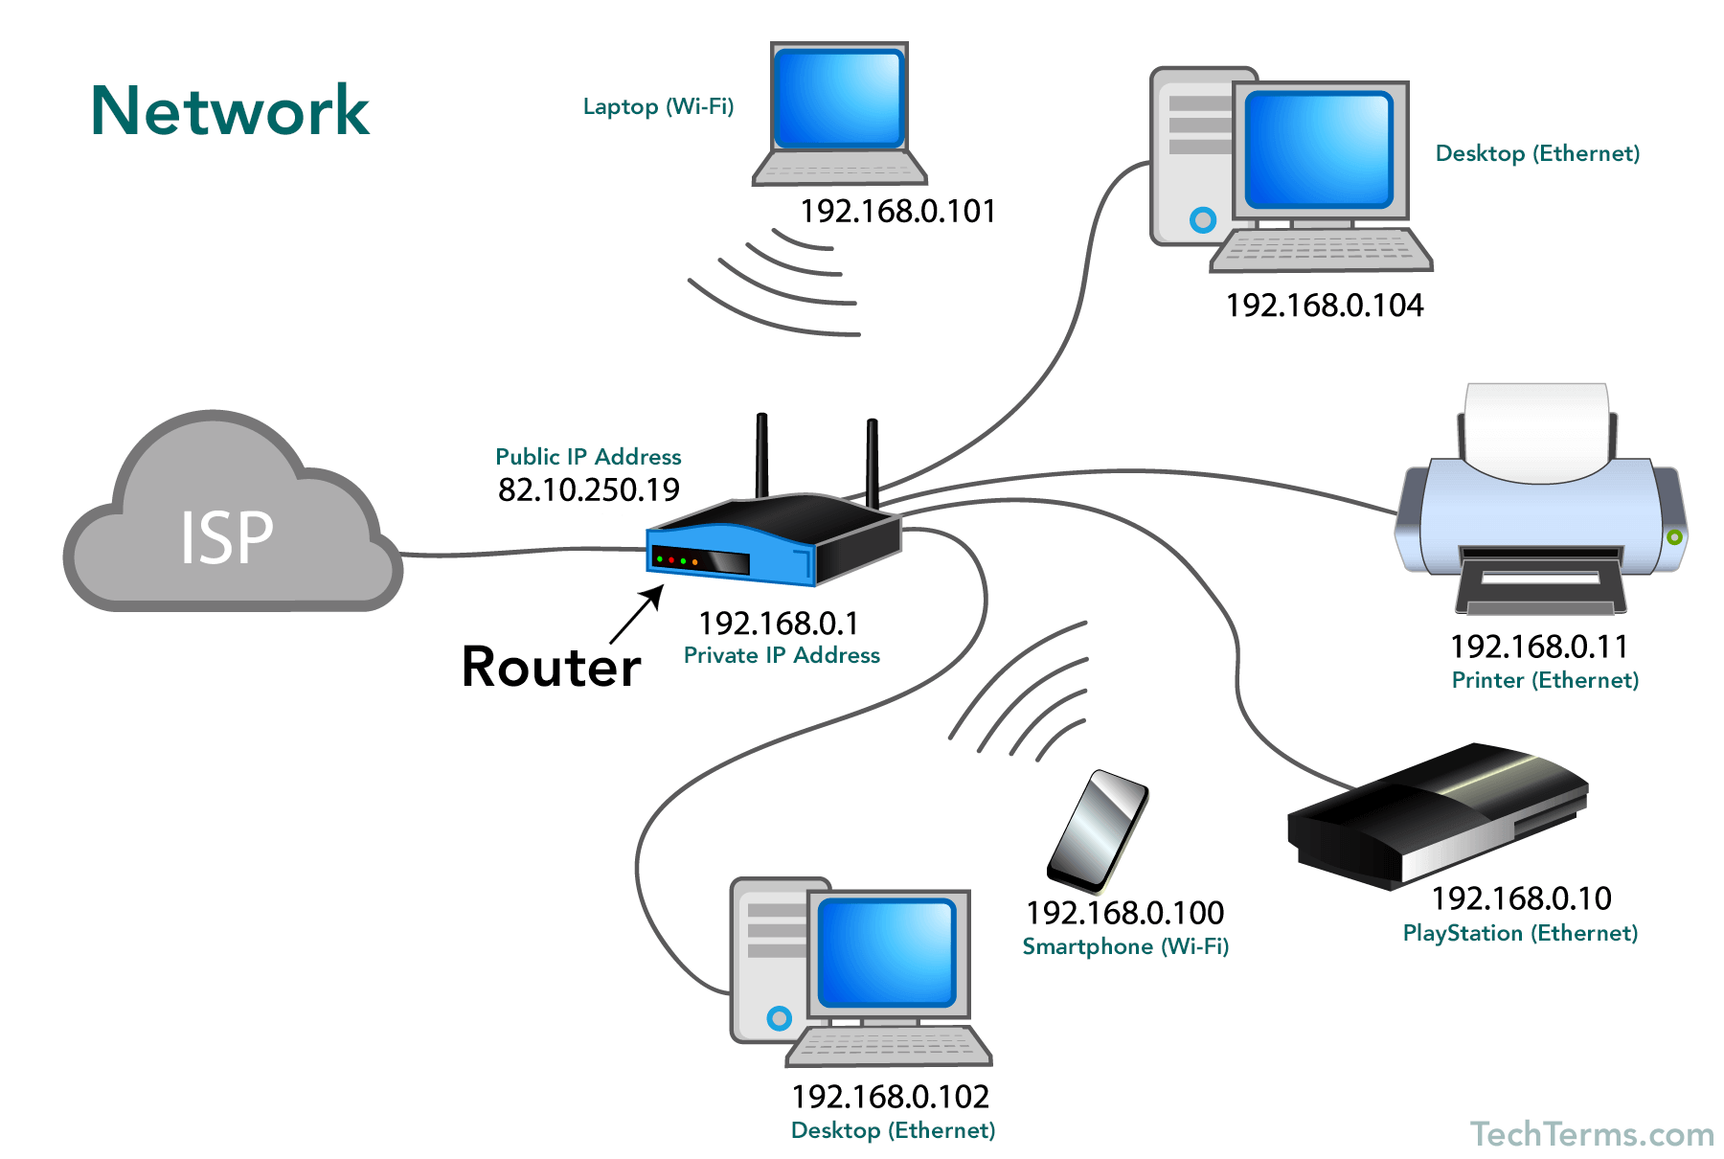



Network attack
Victim machine
Attacker machine

Slide 4
What is Intrusion?
Intrusions: attempts to compromise the confidentiality, integrity, availability, or to bypass the security mechanisms of a computer system or network( illegal access).
Intruders are classified into two groups.
External intruders do not have any authorized access to the system.
Internal intruders have at least some authorized access to the system. misuse their privileges or attempt to gain additional privileges for which they are not authorized.
Although many intrusions are malicious in nature, many others are not; for example: a person might mistype the address of a computer and accidentally attempt to connect to a different system without authorization.
Based on the target, it can be network intrusions or system intrusions. Network intrusions target to attack the network where system intrusions target to attack a particular system.

Slide 5
Types of Intrusions
Network Intrusions: Intrusions are initiated based on a flow of packet sent over a network.
Denial of Service (DoS) attack
Distributed Denial of Service (DDoS) attack.
Man-in-the-Middle attack
IP Spoofing
Port Scanning
Hijack attack
U2R attack
Asymmetric routing
SYN-Flooding
System Intrusions: Host attacks target specific hosts or system by running malicious software to compromise the system functionalities or corrupt it. Most host attacks are categorized under the malware category. This includes worms, viruses, adwares, ransomware.

Slide 6
Denial-of-service Attack
A Denial of Service (DoS) attack: Here, the attacker aims at preventing authorized users to access service provided by server by sending a large number of packets, towards the server.
Here, attacker either consumes all available network bandwidth or consume system resources (mainly CPU, memory, storage space)
As a result, the server is unable to fulfill legitimate requests
A distributed denial of service (DDoS) attack: It is launched from a large number of computers that are infected by malicious software (malware) controlled by attacker.

Slide 7
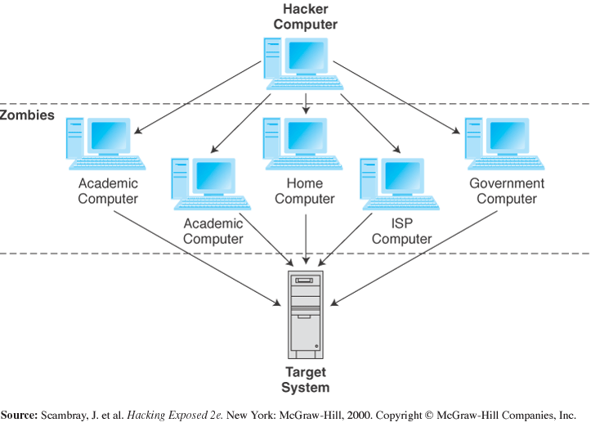
DDoS attack

Slide 8
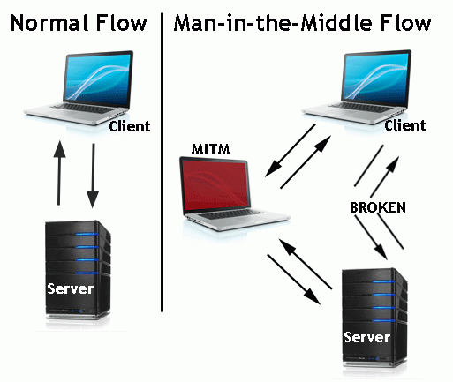
Man-in-the-middle Attack
A man-in-the-middle attack: Here, a malicious actor inserts him/herself into a conversation between two parties, impersonates both parties and gains access to information that the two parties were trying to send to each other. A man-in-the-middle attack allows a malicious actor to intercept, send and receive data meant for someone else, or not meant to be sent at all, without either outside party knowing until it is too late.

Slide 9
Port Scanning Attack
What is Port scanner?
A port scanner is a software application designed to probe a server or host for open ports. This is often used by administrators to verify security policies of their networks and by attackers to identify running services on a host with the view to compromise it.
In this attack, the attacker gets list of open and closed ports. Then attacker lunch attacks against service running on open ports.
This leads attackers to gain entry into organizations and steal their private data.

Slide 10

Phishing
In a phishing attack, an attacker create a fake website that looks similar to popular website site like SBI Bank or PayPal.
Then the attacker send you an email that appears to be from someone you trust, like your boss or a company you do business with. The email will seem legitimate, and it will have some urgency to it (e.g. fraudulent activity has been detected on your account). In the email, there will be a link to click. If you click the link, it will redirect you to a legitimate-looking website, but it is fake website.
When user attempts to log in with their account information, the hacker records user name and password and tries that information in actual website.

Slide 11
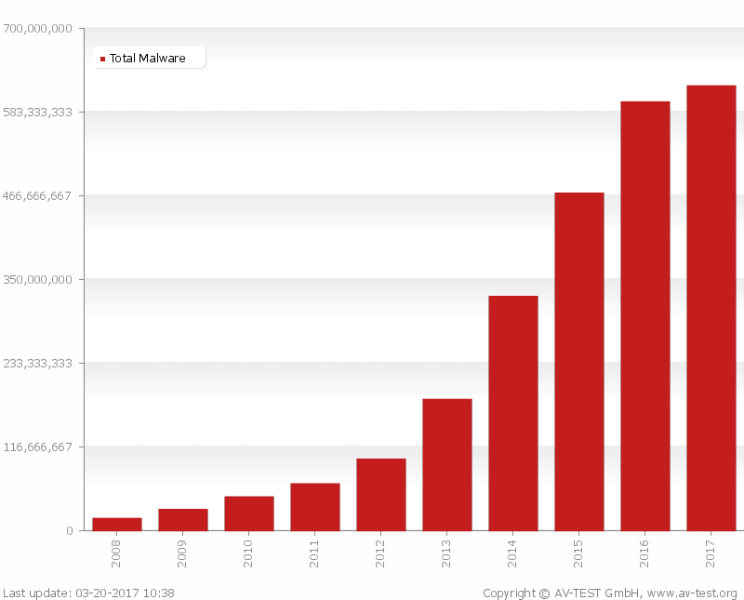
Malware
Malware Attack
MALWARE is
Malicious Software.
Adware, virus,Worm, Ransomware
Malware can do
allow cybercriminals to get into other people’s computers without their permission.
-steal personal information
-delete files
-steal software serial numbers
According to AV-Test in March 2017, the total number of malwares is increasing exponentially since 2008.
Due to such increasing ,it is necessary to detect these files before they harm

Slide 12
Solutions to Intrusions
Firewall: Firewall filters network traffic between your network and outside network based on some rules configured by the administrator.
Intrusion Detection System:
Filtered traffic may contain malicious data
It is a software that monitors the events occurring in a computer system or network and analyzing them for signs of possible intrusions (incidents).
Intrusion Prevention System
It is a software that has all the capabilities of an intrusion detection system and can also attempt to stop possible incidents.

Slide 13
Intrusion Detection System(IDS)
Intrusion detection system (IDS) monitors the network traffic and system-level applications to detect malicious activities in the network
An IDS detects attacks as soon as possible and takes appropriate action.
An IDS does not usually take preventive measures when an attack is detected.
It is a reactive rather than a pro-active agent.
It plays a role of informant rather than a police officer.
It can deal with insider and outsider attacks.
The most popular way to detect intrusions has been using the audit data generated by the operating system.
And audit trail is a record of activities on a system that are logged to a file in chronologically sorted order

Slide 14
IDS Requirements
run continually with minimal human supervision
be fault tolerant
resist subversion
minimal overhead on system
scalable, to serve a large numbe of users
Provide graceful degradation of service
configured according to system security policies
allow dynamic reconfiguration
Notes:
[BALU98] lists the following as desirable for an IDS. It must:
• run continually with minimal human supervision.
• be fault tolerant in the sense that it must be able to recover from system crashes and reinitializations.
• resist subversion. The IDS must be able to monitor itself and detect if it has been modified by an attacker.
• impose a minimal overhead on the system where it is running.
• be able to be configured according to the security policies of the system that is being monitored.
• be able to adapt to changes in system and user behavior over time.
• be able to scale to monitor a large number of hosts.
• provide graceful degradation of service in the sense that if some components of the IDS stop working for any reason, the rest of them should be affected as little as possible.
• allow dynamic reconfiguration; that is, the ability to reconfigure the IDS without having to restart it.

Slide 15
IDS Architecture
Basically, a sophisticated audit system
Agent like logger; it gathers data for analysis. It is also known as sensor.
Director like analyzer; it analyzes data obtained from the agents according to its internal rules
Notifier obtains results from director, and takes some action
May simply notify security officer
May reconfigure agents, director to alter collection, analysis methods
May activate response mechanism

Slide 16
Types of IDS
Detection Model
signature detection vs. anomaly detection
Monitoring Environment
Host based, vs. network based
Operation
Off-line vs. real-time
Architecture
Centralized vs. distributed

Slide 17
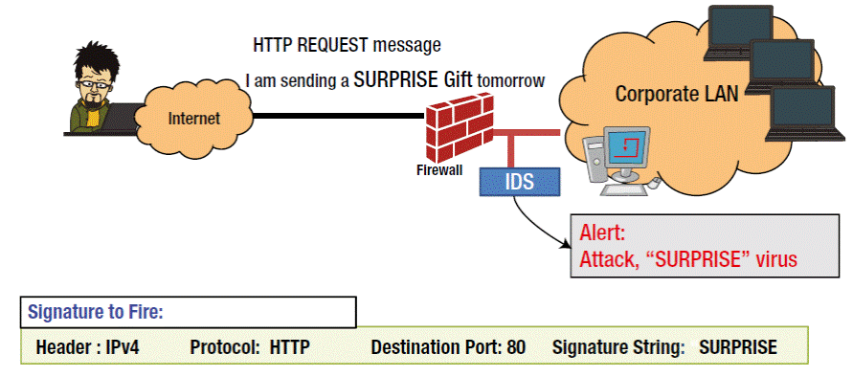
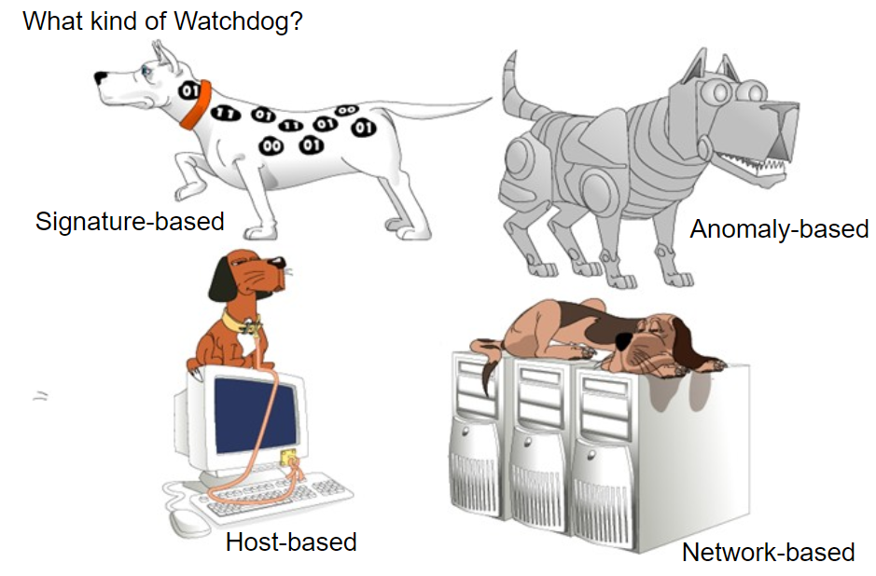
Types of IDS: signature-based
Compares signatures against observed events to identify possible incidents. In case of any matching, an alert is issued.
Source: networkingsphere.com

Slide 18
Types of IDS: signature-based
PROS:
High accuracy
Low FPR (false Positive Rate),
Widely available
Fairly fast
Easy to implement
Easy to update
CONS:
Zero-day or unknown attack
Cannot detect attacks for which it has no signature
frequent update of signatures
Source: networkingsphere.com

Slide 19
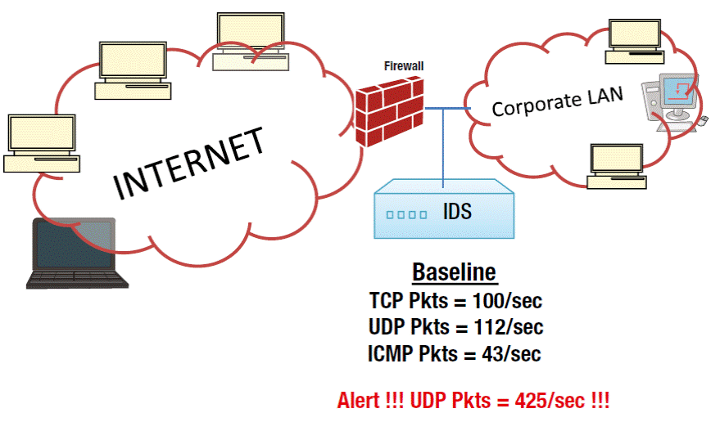
Types of IDS: anomaly-based
Compares definitions of what is considered normal activity with observed events to identify significant deviations.
Source: networkingsphere.com

Slide 20
Types of IDS: anomaly-based
Threshold detection
Checks excessive event occurrences over time
Compute statistics of certain system/network activities
Report an alert if statistics outside range
Example:
For each user, store daily count of certain activities
For example, fraction of hours spent reading email
Maintain list of counts for several days
Report anomaly if count is outside weighted norm
Profile based
Characterize past behavior of users and groups
Then, detect significant deviations
Build it manually (this is hard)
Analysis method (mean and standard deviation, multivariate, etc.) require machine learning and data mining techniques

Slide 21
Types of IDS: anomaly-based
PROS:
Zero-day attack detection
CONS:
High FPR (False Positive Rate)
Greater complexity
slower, more resource intensive
Source: networkingsphere.com

Slide 22
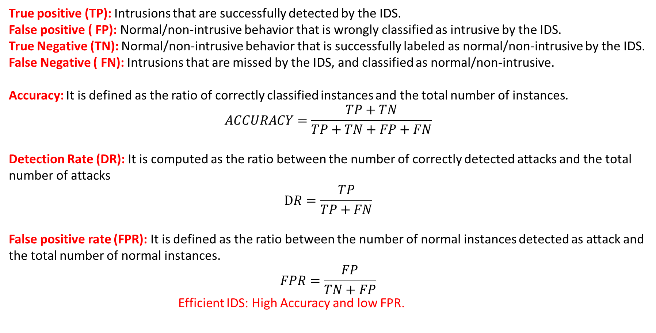
IDS Performance metrics

Slide 23
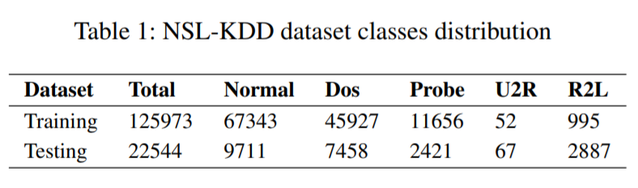
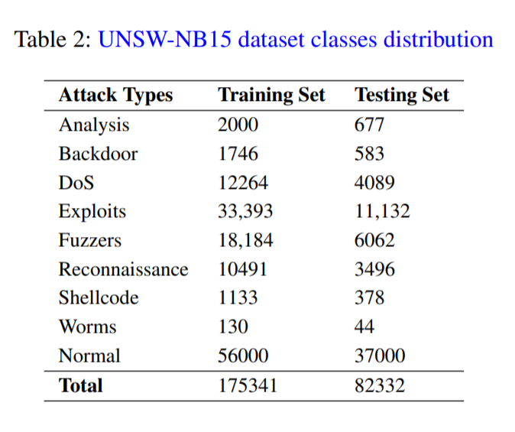
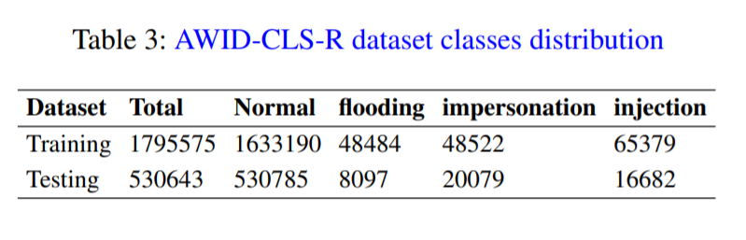
Dataset Description
The NSL-KDD data set is the refined version of the KDD cup99 data set.
In 2015, Moustafa and Slay created a dataset called UNSW-NB15 dataset for research purposes. This dataset contains normal and malicious activities of modern network traffic.
In 2015, Kolias et al. created a dataset named AWID (Aegean WiFi Intrusion Dataset) which contain real traces of both normal and intrusion activities of a 802.11 Wi-Fi network.

Slide 24
Dataset Description: NSL-KDD
Attack Type | Attack Description | Subclass
DOS | system is flooded with connection requests that it doesn’t have sufficient buffer to take actual authentic requests. e.g. Syn flood | Neptune, Smurf, Pod, Teardrop, Landback, Teardrop, Mailbomb, Processtable, Udpstorm, Apache2, Worm
PROBE | attacker claims to avoid the security controls of a network and gather possible information under this context. e.g. Port scanning. | Portsweep, IPSweep, Nmap, Satan, Mscan, Saint
U2R | attacker tries to gain access to the root privileges of the system by various means. | BufferOverflow, LoadModule,Perl, Rootkit, Sqlattack, Xterm, Ps
R2L | intruder has the right to send packets into network. This is used to manipulate and gain access. e.g. Guessing password. | Guesspassword, Ftpwrite, Imap, Phf, Multihop, Warezmaster, Xlock, Xsnoop, Snmpguess, Snmpgetattack, Httptunnel, Sendmail, Named

Slide 25
Dataset Description: UNSW-NB15
Attack Type | Attack Description
FUZZERS | Attempting to cause a program or network suspended by feeding it the randomly generated data
Analysis | It contains different attacks of port scan, spam and html files penetrations.
Backdoor | A technique in which a system security mechanism is bypassed stealthily to access a computer or its data.
DoS | A malicious attempt to make a server or a network resource unavailable to users, usually by temporarily interrupting or suspending the services of a host connected to the Internet
Exploit | The attacker knows of a security problem within an operating system or a piece of software and leverages that knowledge by exploiting the vulnerability
Generic | A technique works against all block ciphers (with a given block and key size), without consideration about the structure of the block-cipher.
Reconnaissance | Contains all Strikes that can simulate attacks that gather information.
Shellcode | A small piece of code used as the payload in the exploitation of software vulnerability.
Worms | Attacker replicates itself in order to spread to other computers. Often, it uses a computer network to spread itself, relying on security failures on the target computer to access it.

Slide 26
Dataset Description: AWID
Attack Type | Attack Description | Subclass
Flooding | designed to cause an interruption or suspension of services of a specific host/server by flooding it with large quantities of useless traffic or external communication requests. When the Denial of Service (DoS) attack succeeds the server is not able to answer even to legitimate requests any more - this can be observed in numbers of ways: slow response of the server, slow network performance, unavailability of software or web page, inability to access data, website or other resources. | deauthentication, authentication request, amok, probe request, probe response
Impersonation | Impersonation takes the form of device cloning, address spoofing, unauthorized access, rogue base station (or rogue access point) and replay. For example, in an evil twin setup, the client(s) unknowingly connect to them under the pretext that they are connected to a genuine access point. Once a client is connected, an attacker eavesdrops on its communication to hijack clients communication, re-direct clients to malicious websites, steal credentials of the clients connecting to it | evil-twin, caffe-latte, hirte
Injection | Attacker uses existing vulnerabilities in the applications to inject a code/string for execution that exceeds the allowed and expected input to the system requested, e.g. inject a client-side script onto the webpage or an SQL database | arp, fragmentation, chop chop

Slide 27

Till Now: Lot of Cyber Attacks !
How to protect our devices ?
Notes:
Network: DOS, Man in the middle, Phishing, host: malware

Slide 28

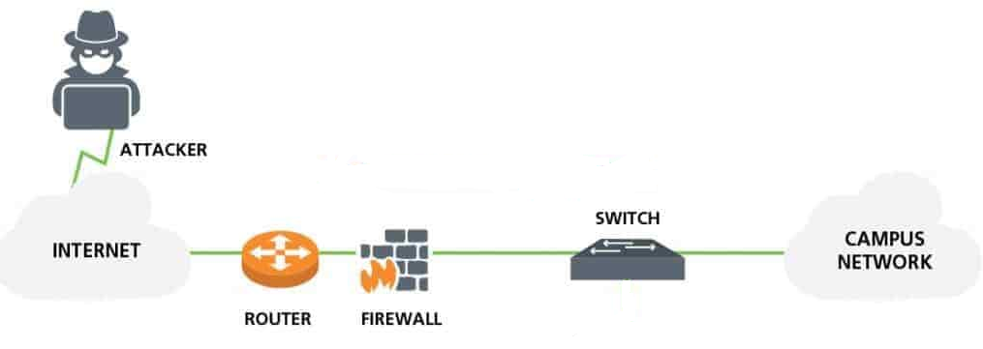
Firewall: first line of defense
Rashtrapati Bhavan.(Reuters File Photo)
Source: digitalplanet

Slide 29
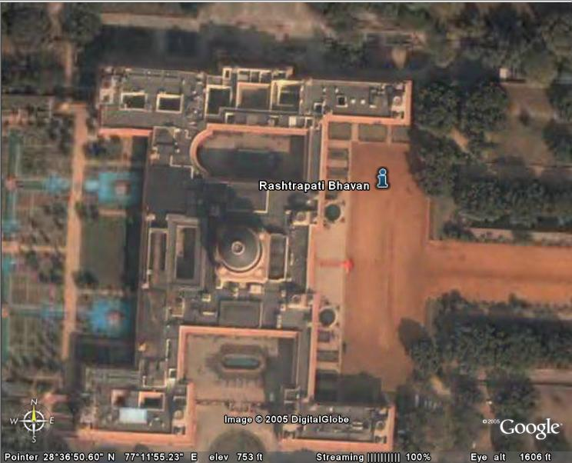
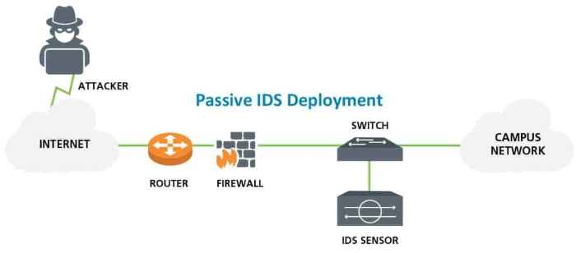
Intrusion Detection System: Second line of defense
checkpoint1
checkpoint2
Rashtrapati Bhavan(Reuters File Photo)
Source: digitalplanet
Notes:
Not in line of network, VPN connection, active IDS

Slide 30
Motivation for Machine Learning based IDS
Current network environments are complex and dynamic due to the emergence of novel attacks and continuous changes in attack pattern.
CONS of rule-based methods:
1. regular updates
2. static
3. frequent human intervention for creating new rules for novel attacks
Therefore, need for a IDS that is
1. adaptive
2. dynamic
3. require least human intervention
Notes:
Static: not continuously changing attack scenarios

Slide 31
Heuristics/ Rule based
ML
Anomaly
detection
ML-based IDS

Slide 32
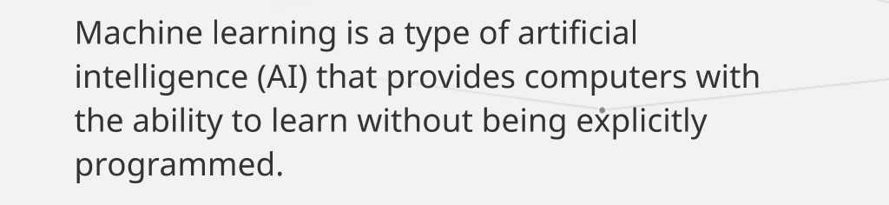

Slide 33
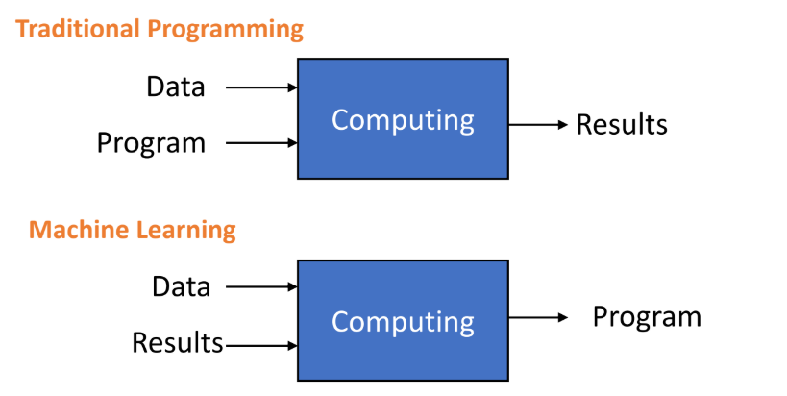
ML vs Traditional programming

Slide 34
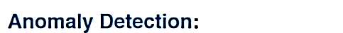
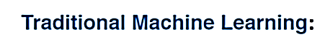
find novel attacks, identify never seen before attacks (zero-day attacks)
Learn patterns, identify similar things.
Notes:
Next: Adversarial Learning

Slide 35
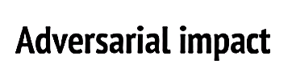

Advanced actors can create perturbation to bypass the system

Slide 36


Many false positives
Lack of proper training data
What data to train model on?
Clean input data
Used without deep understanding of model
Advanced ML-IDS
Get excited

Slide 37

Improper understanding leads to gap between requirements and applications of the model.
Misaligned bridge
Copyright@ National Oceanic and Atmospheric Administration (NOAA)

Slide 38
Reducing gap between requirements and applications of the model.
Misaligned bridge
Copyright@ National Oceanic and Atmospheric Administration (NOAA)
Notes:
Next: important methods to prevent mistakes

Slide 39
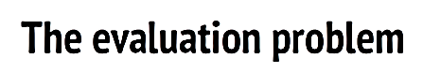

Devising a sound evaluation scheme.
Getting the right features (most difficult task)
Getting the right model
Let’s begin!
Notes:
Before click: With this in mind, lets begin our discussion
Next: last minutes exams.

Slide 40
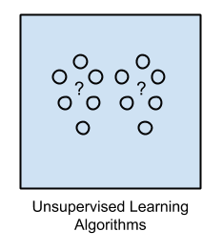
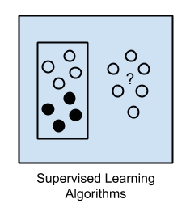
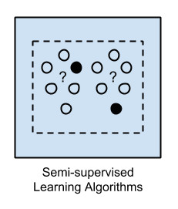

Taxonomy of ML
ML
Unsupervised
Learning
Supervised
Learning
Semi-Supervised
Learning
Reinforcement Learning
Some Input data is labelled.
Input data is labelled dynamically
Input data is not labelled.
Input data is labelled.
https://machinelearningmastery.com/a-tour-of-machine-learning-algorithms/
Notes:
Reinforcement Learning: game playing, so you can know which action is best, super mario game ( use black board):
Next: look at the avenger of IDS

Slide 41

Unsupervised
learning
3. DT
Supervised
learning
4. DNN
2. KNN
5. SVM
6. DQN
Reinforcement
learning
1. K-means
ML-IDS

Slide 42
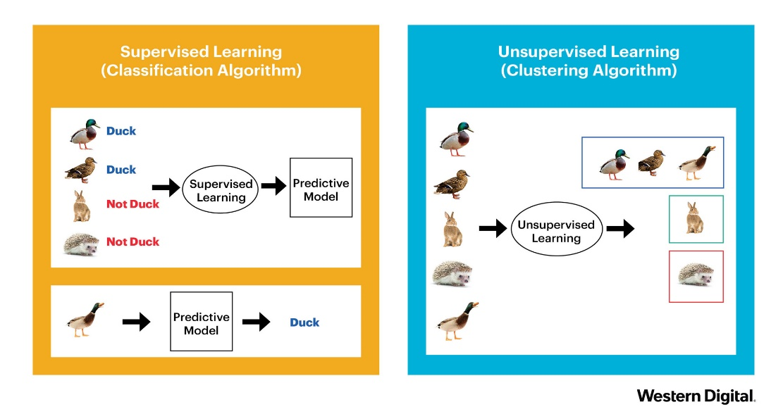
Supervised learning
A model is prepared through a training process in which it is required to make predictions and is corrected when those predictions are wrong.
The training process continues until the model achieves a desired level of accuracy on the training data.
Courtesy: Western Digital https://www.datanami.com/2018/09/05/how-to-build-a-better-machine-learning-pipeline/

Slide 43

What is Reinforcement Learning ?
Reinforcement learning or RL for short is the science of decision making or the optimal way of making decisions.
Agent takes actions, receives observations from the environment that consists of a reward for his action and information of his new state. That reward informs the agent of how good or bad was the taken action, and the observation tells him what is his next state in the environment.
Source: Madhu Sanjeevi (medium)
Notes:
Attending the winter school based on the feedback you have for this year session, game of mario for discussing about agent and reward

Slide 44
Research work: Deep RL
K Sethi, ES Rupesh, R Kumar, P Bera, YV Madhav, "A context-aware robust intrusion detection system: a reinforcement learning-based approach“ International Journal of Information Security, 1-22
Detection and prevention of intrusions in enterprise networks and systems is an important, but challenging problem due to extensive growth and usage of networks that are constantly facing novel attacks. An intrusion detection system (IDS) monitors the network traffic and system-level applications to detect malicious activities in the network. However, most of the existing IDSs are incapable of providing higher accuracy and less false positive rate (FPR). Therefore, there is a need for adaptive techniques to detect network intrusions that maintain a balance between accuracy and FPR. In this paper, we present a context-adaptive IDS that uses multiple independent deep reinforcement learning agents distributed across the network for accurate detection and classification of new and complex attacks. We have done extensive experimentation using three benchmark datasets including NSL-KDD, UNSW-NB15 and AWID on our model that shows better accuracy and less FPR compared to the state-of-the-art systems. Further, we analyzed the robustness of our model against adversarial attack and observed only a small decrease in accuracy as compared to the existing models. To further improve the robustness of the system, we implemented the concept of denoising autoencoder (DAE). Also, we have shown the usability of our system in real-life application with changes in the attack pattern

Slide 45
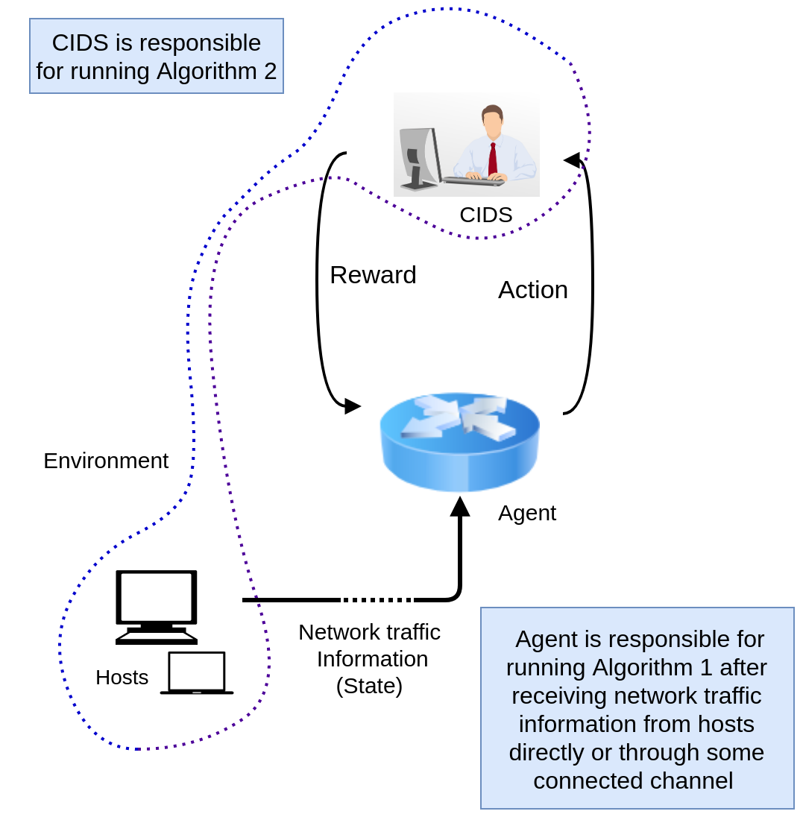
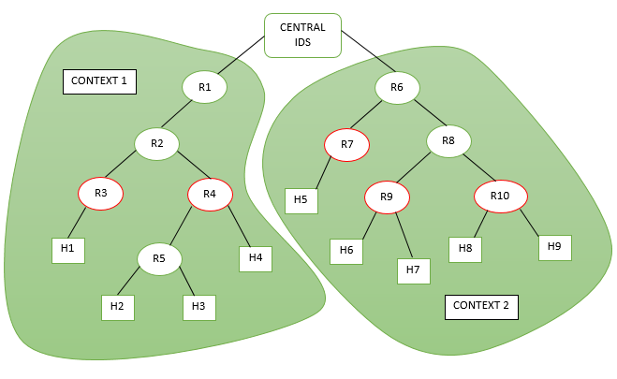
Network Deployment of model
confidential

Slide 46
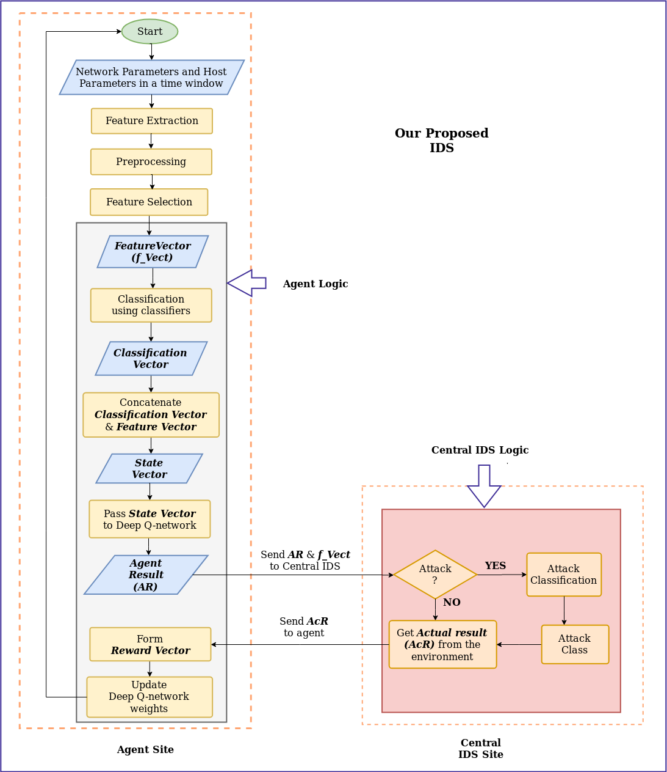
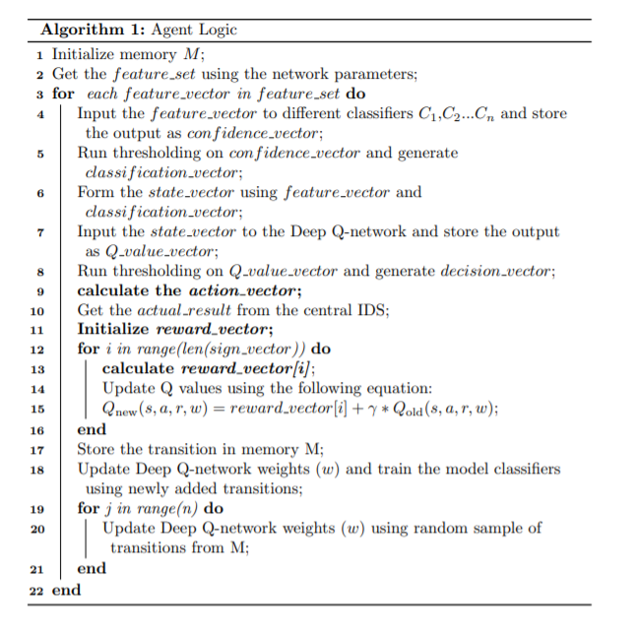
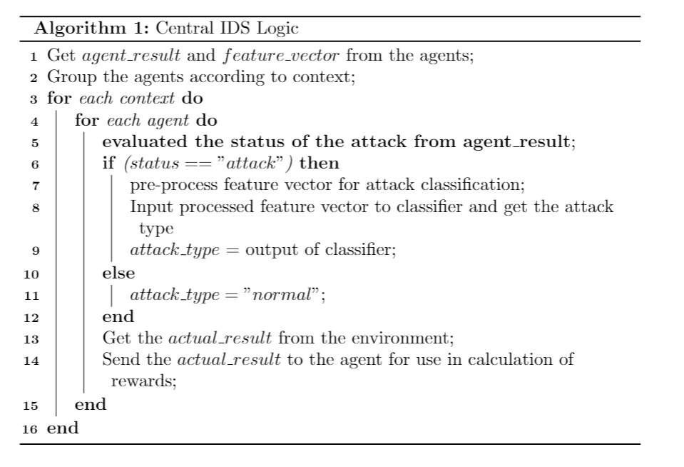
Algorithm and Workflow
confidential

Slide 47
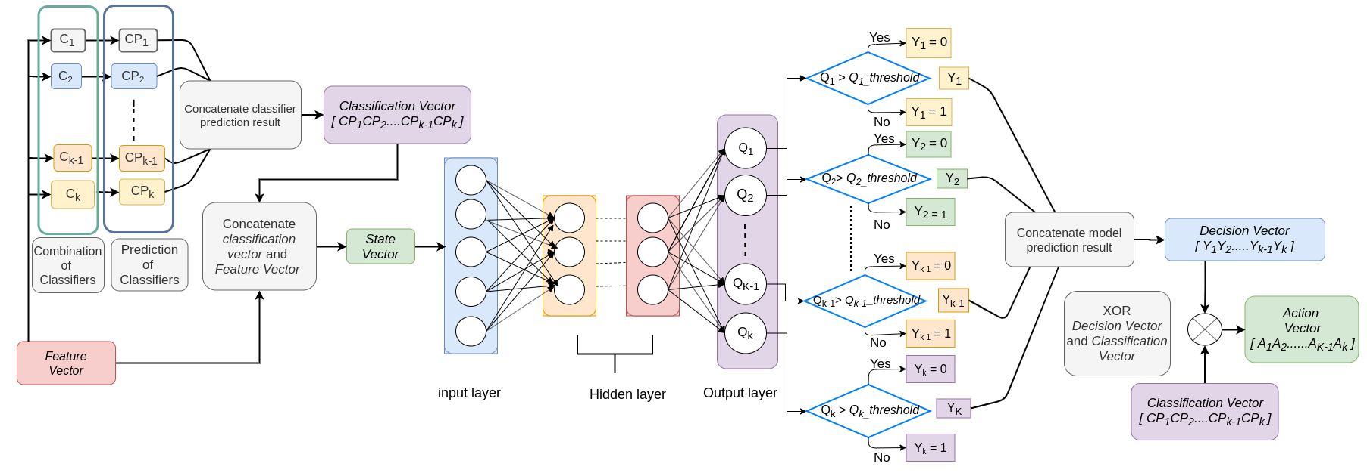
Agent Result Calculation

Slide 48
Agent result Calculation
confidential

Slide 49
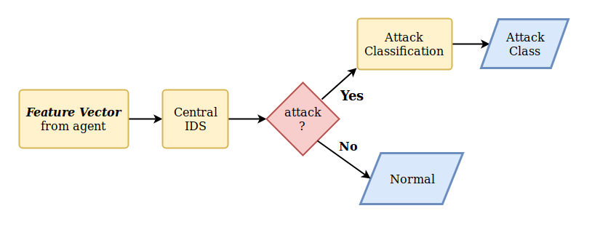
Environment
confidential
Notes:
How to make correlation with the state transition and other factors.

Slide 50
Reward Calculation
confidential

Slide 51
Experience Replay
confidential

Slide 52
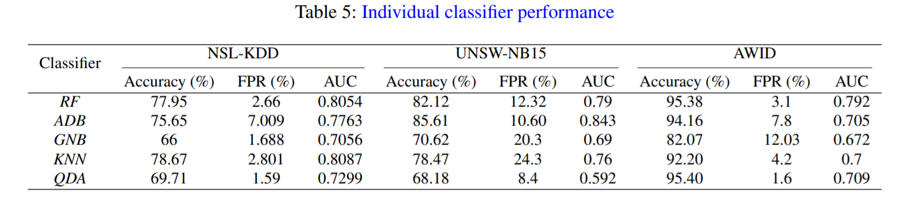
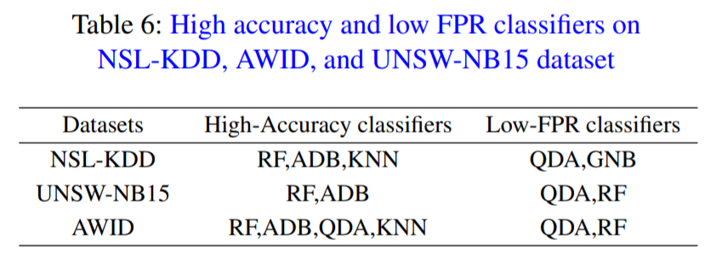
Performance of individual classifier
confidential

Slide 53
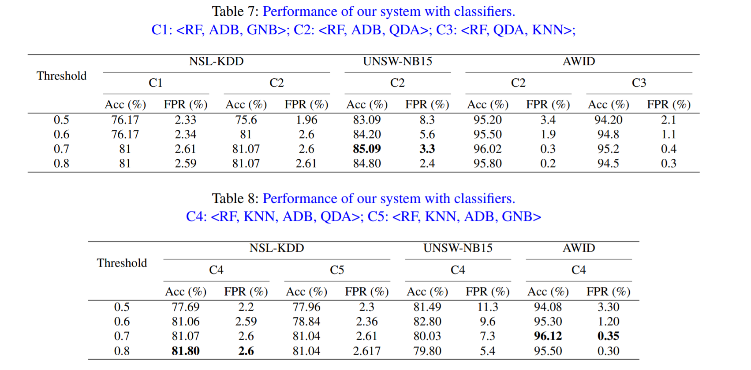
Performance of model with diff. combination
confidential

Slide 54
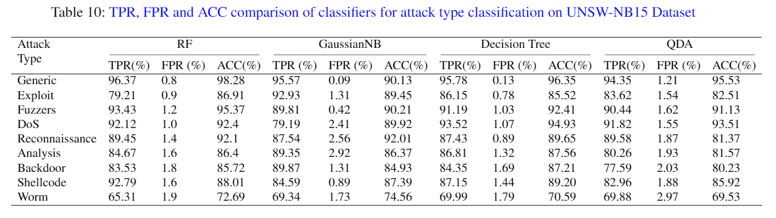
Attack type classification performance for UNSW-NB15

Slide 55
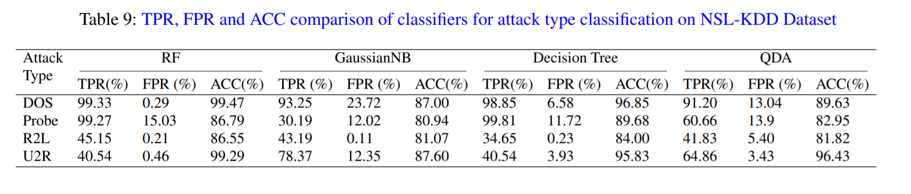
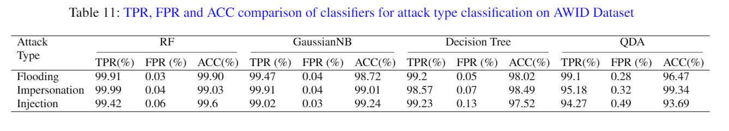
Attack type classification performance for
NSL-KDD and AWID
confidential

Slide 56
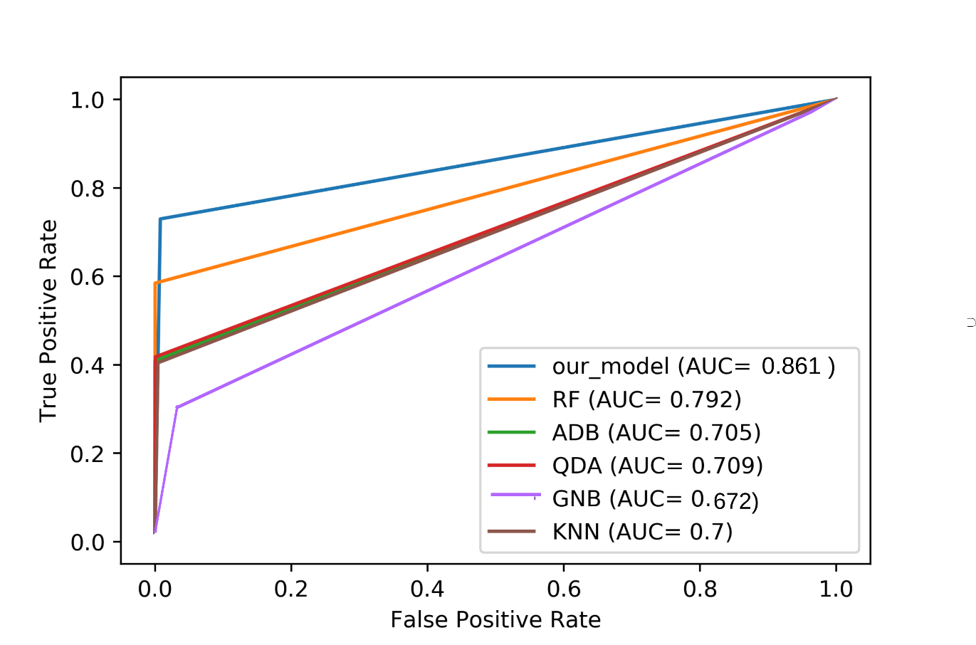
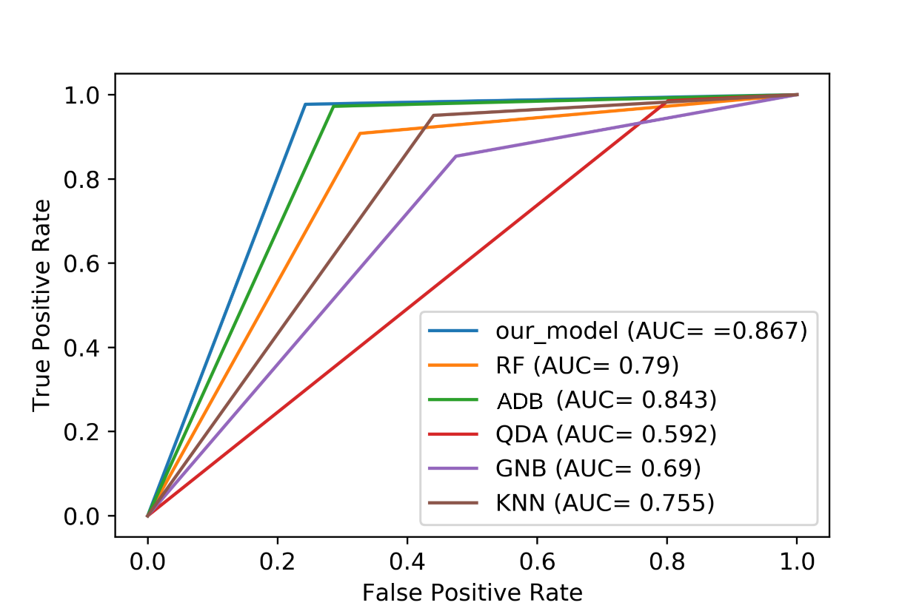
ROC curve for AWID and UNSW-NB15
confidential

Slide 57
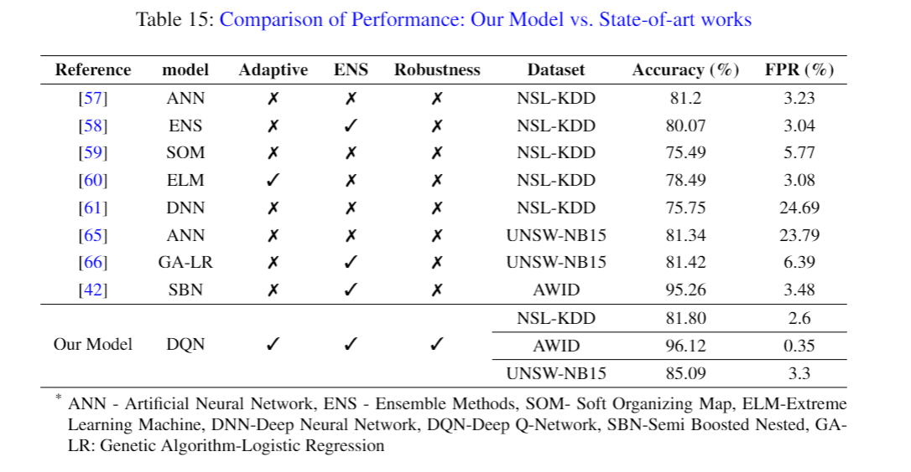
Comparison of proposed IDS with state-of-art work

Slide 58
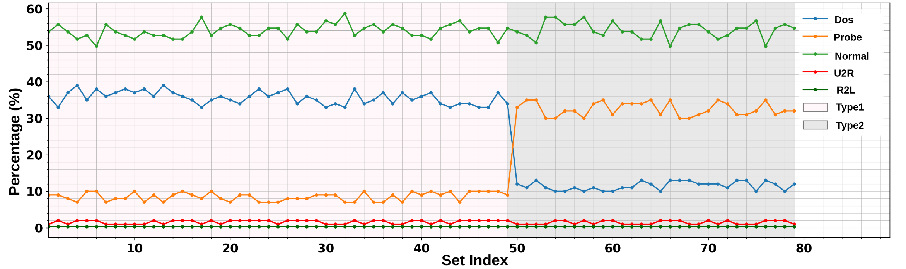
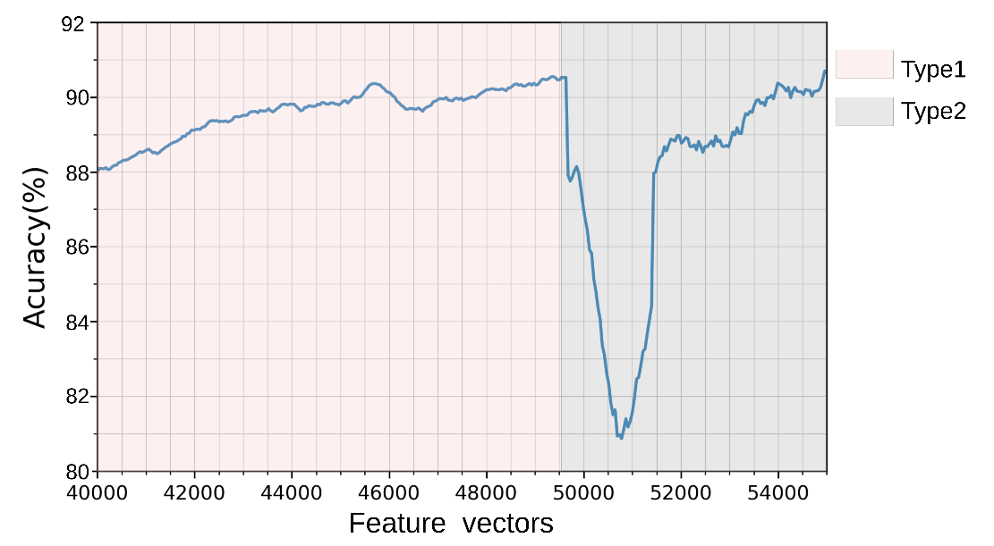
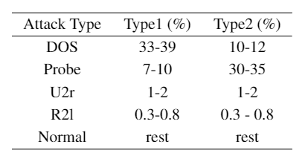
Model Evaluation in changing attack pattern
Table: Distribution of attack types in two different attack patterns
(% value in 1000 samples)
confidential

Slide 59
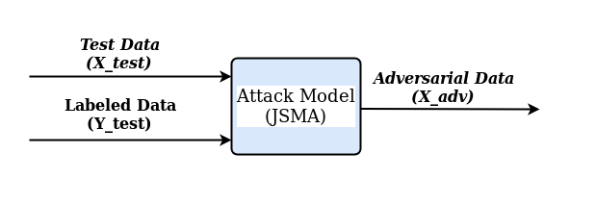
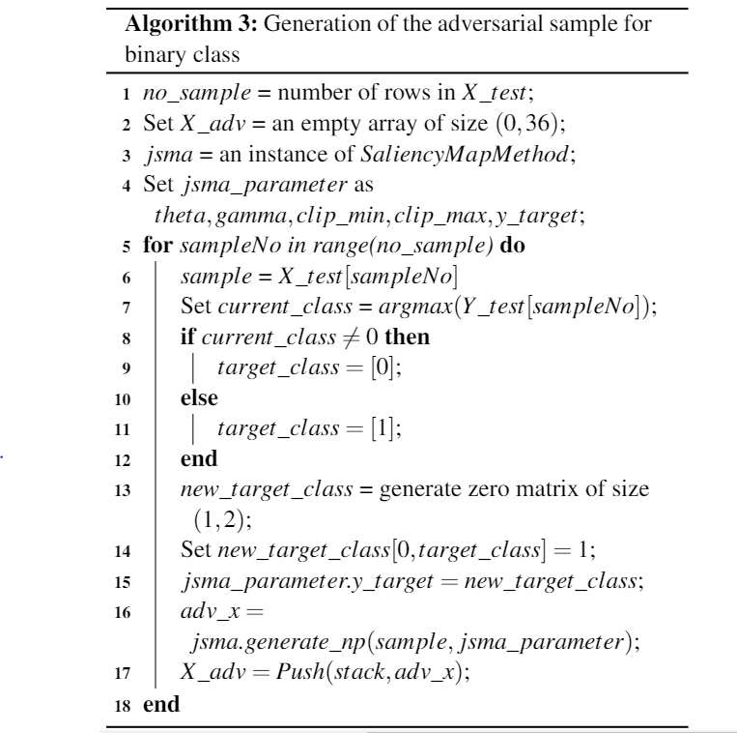
Adversarial Data generation
The objective of any adversarial model is to add small perturbations that are similar to normal samples.
Jacobian-based Saliency Map Attack (JSMA): It is a simple white-box (i.e., the attacker has access to the model’s parameters) iterative method to misclassify the target model. This method allows the use of forward derivative of DNN to generate adversarial perturbation.
confidential

Slide 60
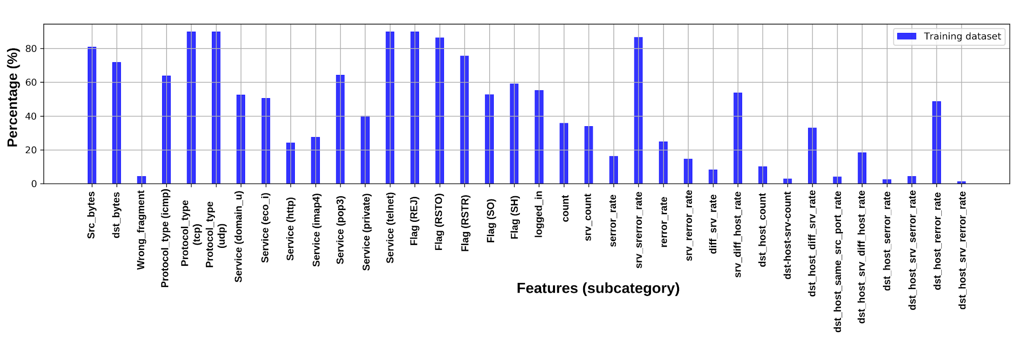
Adversarial output deviation percentage

Slide 61
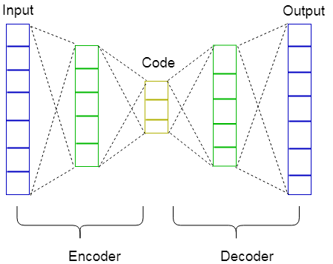
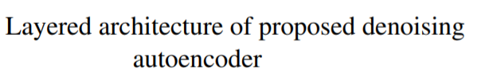
Denoising Auto-encoder (DAE)
DAE is a deep neural network which maps n inputs to n outputs.
It takes an adversarial dataset (i.e., corrupted dataset) as input and is trained to predict the unperturbed dataset (i.e., uncorrupted dataset) as its output. It consists of two components namely encoder and decoder.
Encoder reduces the dimension of the input data to produce code which is a compressed representation of the input data and decoder reconstructs the output data from the code.
confidential

Slide 62
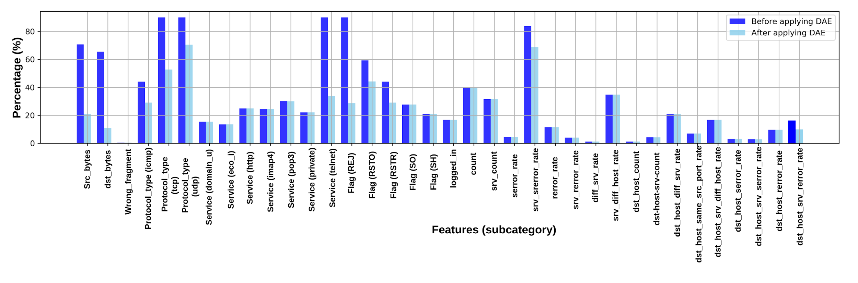
Denoising output deviation percentage

Slide 63


Comparison of model against adversarial dataset
Table: Robustness of our system against adversarial
Attack
Table: Comparison of Robustness on NSL-KDD: Our Model vs. [R1]
[62] K. Yang, J. Liu, C. Zhang and, Y. Fang, "Adversarial Examples Against the Deep Learning Based Network Intrusion Detection Systems," IEEE Military Communications Conference (MILCOM), Los Angeles, CA, USA, pp. 559-564, (2018). DOI: 10.1109/MILCOM.2018.8599759

Slide 64

Intrusion Detection & Malware Injection for Drones
Rapid adoption of UAVs (surveillance, delivery, inspection)
Safety, privacy, and mission integrity are critical
Drones are resource-constrained: limited CPU, memory, battery
Ground Control Station
Many operate in hostile/untrusted environments
Successful malware injection can let attackers hijack drones or steal their data.

Slide 65
Threat model & attack surfaces
Remote command/control links (radio, Wi‑Fi, LTE) intercepted & Spoofed
Ground Control Station (GCS) compromise
Supply-chain & software updates (malicious firmware/patches)
Sensor spoofing & data injection (GPS spoofing, false telemetry)
Physical access (pre-deployment tampering)
Attacker goals: take control of the drone, steal data, stay hidden, and disrupt the mission.

Slide 66
Malware injection techniques for drones
Firmware trojans: altered bootloader, compromised firmware images
Boot-time persistence: rootkits in boot/RTOS layer
Application-layer malware: malicious payloads in mission software
Compromised update channels: MITM or malicious update servers
Side-channels & covert channels: encode commands in telemetry or timing
Example: Poisoned OTA update that installs a backdoor into autopilot.
Notes:
Real-Time Operating System (RTOS) layer
Over-The-Air (OTA)

Slide 67
IDS approaches for drones (overview)
Host-based IDS (HIDS): monitor process behavior, file integrity, system calls
Network-based IDS (NIDS): inspect radio/Wi‑Fi/LTE traffic patterns and anomalies
Hybrid approaches: combine lightweight HIDS on-board + NIDS at GCS/edge
Specification-based: check behavior against safe flight/state machine rules
Signature-based: known-malware fingerprints (limited for zero-day)
Trade-offs: detection accuracy vs. resource cost and false positives.

Slide 68
ML-based detection & datasets
Anomaly detection: unsupervised methods (Autoencoders, Isolation Forest)
Supervised classification: Random Forest, SVM, deep networks for labeled malware/benign traces
Input data types:
Telemetry logs (GPS, altitude, velocity, attitude angles)
System logs (CPU usage, memory consumption, sensor status)
Network captures (PCAPs) containing packet metadata and timing patterns
Command/control logs from GCS-UAV communication
Notes:
PCAPs :packet capture

Slide 69
ML-based detection & datasets
Metadata examples: timestamp, location, drone ID, flight mode, signal strength, link latency, packet loss rate
Features extracted: telemetry (GPS, altitude), communication metadata, CPU/memory usage, system call patterns
Available drone datasets/testbeds:
Drone-Based Malware Detection dataset (Kaggle) : Includes detailed network traffic, drone sensor readings, malware indicators, and environmental data.
UAVSim – simulated UAV network traffic with attacks
ISOT Drone Anomaly Detection Dataset – Real DJI Tello drone traffic (PCAP and CSV files) containing benign and anomalous communication traces.
Drone-Hunter – intrusion and anomaly events for UAV communication
CUAV (Colorado UAV Testbed) – telemetry + network logs for ML research

Slide 70
Challenges & limitations
Resource constraints: compute, memory, battery
Diverse platforms/firmware — limited portability of signatures
Real-time constraints: detection must be fast and actionable
Evasion/adversarial attacks against ML detectors
False positives risk mission aborts; false negatives risk compromise
Lack of public benchmarks and realistic datasets

Slide 71
Mitigations & best practices
Secure boot and cryptographic firmware signing (OTA integrity checks)
Encrypted & authenticated communication channels (mutual TLS, secure radio links)
Minimal trusted computing base (isolate critical flight control code)
Regular attestation and remote integrity verification
Defense-in-depth: runtime monitors + anomaly detectors + failsafe behaviors (Return-to-Home (RTH), loiter)
Supply-chain security: vendor vetting and reproducible builds

Slide 72

Cloud IDS system

Slide 73
K. Sethi, R. Kumar, P. Bera et. Al., "A Novel Machine Learning Based Malware Detection and Classification Framework," 2019 International Conference on Cyber Security and Protection of Digital Services (Cyber Security)
Oxford, United Kingdom, 2019, pp. 1-4. doi: 10.1109/CyberSecPODS.2019.8885196
As time progresses, new and complex malware types are being generated which causes a serious threat to computer systems. Due to this drastic increase in the number of malware samples, the signature-based malware detection techniques cannot provide accurate results. Different studies have demonstrated the proficiency of machine learning for the detection and classification of malware files. Further, the accuracy of these machine learning models can be improved by using feature selection algorithms to select the most essential features and reducing the size of the dataset which leads to lesser computations. In this paper, we have developed a machine learning based malware analysis framework for efficient and accurate malware detection and classification. We used Cuckoo sandbox for dynamic analysis which executes malware in an isolated environment and generates an analysis report based on the system activities during execution. Further, we propose a feature extraction and selection module which extracts features from the report and selects the most important features for ensuring high accuracy at minimum computation cost. Then, we employ different machine learning algorithms for accurate detection and fine-grained classification. Experimental results show that we got high detection and classification accuracy in comparison to the state-of-the-art approaches.

Slide 74

What is Cuckoo?
Cuckoo Sandbox is the leading open source automated malware analysis system.
You can throw any suspicious file at it and in a matter of minutes Cuckoo will provide a detailed report outlining the behaviour of the file when executed inside a realistic but isolated environment.
https://cuckoosandbox.org/

Slide 75

Malware Detection operation workflow
Fig: Operational flow of
proposed methodology

Slide 76


Results
Fig: ROC curve for
decision tree classifier
Table : Malware family classification results using our proposed method

Slide 77

Malware family classification
Table : Malware family classification results using our proposed method

Slide 78
References
Topic | Description
Intrusions | https://www.dnsstuff.com/intrusion-detection-system
Intrusions Detection system | https://www.sans.org/reading-room/whitepapers/detection/intrusion-detection-systems-definition-challenges-343
Firewall | https://resources.infosecinstitute.com/network-design-firewall-idsips/#gref
Unsupervised learning | http://is.tuebingen.mpg.de/fileadmin/user_upload/files/publications/taxo_[0].pdf
Generative Vs Discriminative | https://medium.com/@mlengineer/generative-and-discriminative-models-af5637a66a3
Machine Learning Videos | https://statquest.org/video-index/
Neural Network | https://www.doc.ic.ac.uk/~nuric/teaching/imperial-college-machine-learning-neural-networks.html

Slide 79
References
Topic | Description
Taxonomy of ML | https://subscription.packtpub.com/book/big_data_and_business_intelligence/9781783558742/1/ch01lvl1sec12/taxonomy-of-machine-learning-algorithms
Challenges of IDS | https://www.sans.org/reading-room/whitepapers/detection/intrusion-detection-systems-definition-challenges-343
Detecting Network Intrusions With Machine Learning Based Anomaly Detection Techniques | https://www.youtube.com/watch?v=c71gt-I8Lik
Introduction to ML | https://machinelearningmastery.com/a-tour-of-machine-learning-algorithms/
Email: Kamalakanta Sethi: ks23[at]iitbbs.ac.in Rahul Kumar:rk36[@]iitbbs.ac.in

Slide 80
Thank You !

